Slide 1
CSC101 – Introduction to ICT Lecture 07 Loops
Course Instructors
Dr. Majid Iqbal Khan Dr. Ashfaq Hussain Farooqi Mr. Rizwan Rashid Ms. Sajida Kalsoom

Slide 2
Agenda
Why to use loops
What are loops
Types of loops in Python
While
For
Keywords break and continue
Summary

Slide 3
Why to use loops?
When we have to repeat a set of instructions for a (bounded) number of times
Print “Hello world” 5 times
Start
Start
print(“Hello world”)
print(“Hello world”)
print(“Hello world”)
print(“Hello world”)
print(“Hello world”)
Repeat 5 times
Manual
Loops
print(“Hello world”)
End
End

Slide 4
What are loops
Start
Loops allow the execution of one or more statements multiple times
There are certain conditions to enter the loop that are defined at the start of the loop
As long as the condition remains True loop keeps on repeating itself
Once the condition becomes False the loop exits and the control moves to the next statement after the loop
Conditional code
Condition
If condition is True
If condition is False
End
Depending on the condition loop can be
Finite loop
Infinite loop

Slide 5
Loops in Python
Loops
While
For
Nested
Similar to nested conditional statements

Slide 6
The while Loop
While loops are also known as conditional loops. Each loop contains a loop-continuation-condition, a Boolean expression that controls the execution of loop.
A single execution of a loop body is called an iteration.
Start
Loop condition?
Syntax:
while Boolean expression:
statements
True
False
Body of the loop
End

Slide 7
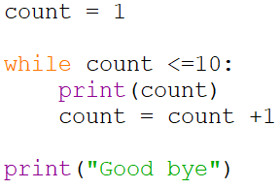
The while Loop
Example: Program that print numbers from 1 to 10
Start
count = 1
count <=10
True
False
count+=1
print count
print “Good bye”
End

Slide 8
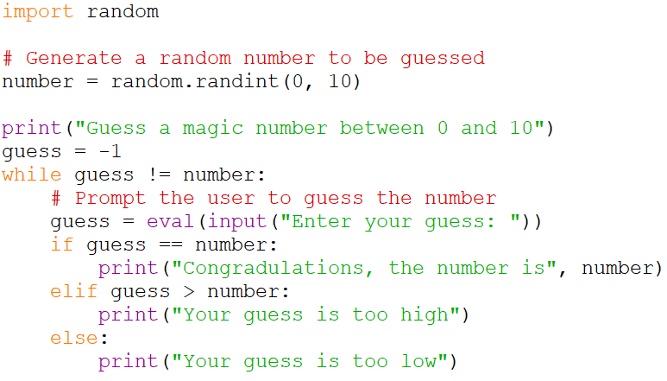
The while Loop
Example: Guessing Numbers
Program generates a random number between 0 and 10. (suppose 6)
User tries to guess the number
Input number: 3
Number is too small
Input number: 8
Number is too large
Input number: 6
Congratulations

Slide 9
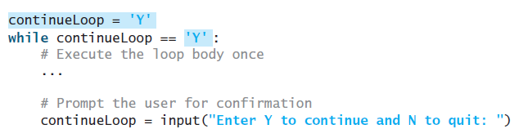
Controlling a Loop with User Confirmation
Number of iterations of a loop can be controlled based on the user feedback
The template of the program can be coded as follows:

Slide 10
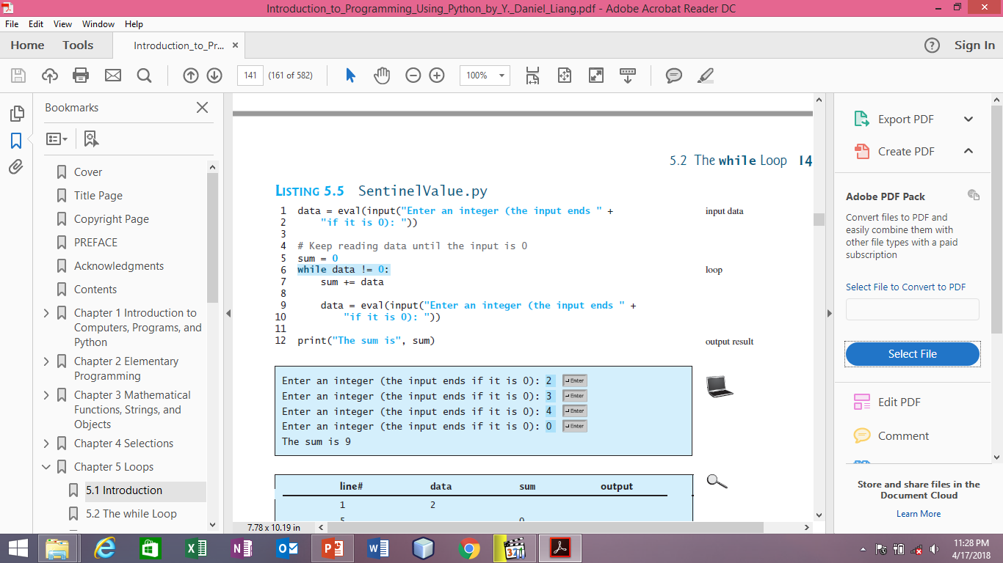
Controlling a Loop with a Sentinel Value
Common technique for controlling a loop is to designate a special input value, known as a sentinel value, which signifies the end of the input.
A loop that uses a sentinel value in this way is called a sentinel-controlled loop.

Slide 11
The for Loop
A Python for loop iterates through each value in a sequence.
Often one know exactly how many times the loop body needs to be executed, so a control variable can be used to count the executions.
A loop of this type is called a counter-controlled loop.
The syntax of a for loop has following information :
A sequence is the collection of data items stored one after the other, often defined using range()
The variable var takes on each successive data item in the sequence as its value.
for var in sequence:
# Loop body

Slide 12
The for Loop examples
Example 1: range(initialValue, endValue)
for i in range (0, 4):
print (i)
Output: range(0, 4) and range(4) are same
0
1
2
3
Example 2:
range(initialValue, endValue, stepsize)
for i in range (3, 9, 2):
print (i)
Output:
3
5
7
Example 3: range(initialValue, endValue, -stepsize)
for i in range (5, 2, -1):
print (i)
Output:
5
4
3

Slide 13
The for Loop example
Find the factorial of a number, here for loop is a better choice as we know the number of iterations
4! = 4 * (4-1) * (4-2) * (4-3)

Slide 14
Keywords break and continue
Using break and continue can simplify programming in some cases.
Overusing or improperly using them, however, can make programs difficult to read and debug.
Example for break: Recall number guessing game that we developed using while loop
What if a user wants to quit in the middle of the game?

Slide 15
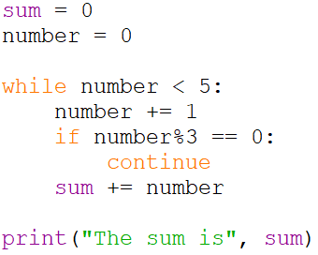
Keywords break and continue
continue keyword breaks out of an iteration, while the break keyword breaks out of a loop.
Example for continue: Take the sum of all the numbers between 1 and 5 except those that are divisible by 3.
Sum -> 1+2+4+5 = 12

Slide 16
Summary
We have discussed the need of loops in the programming languages
Types of loops in Python
Keywords break and continue
Next session will discuss nested loops
While
For

